Slide 1
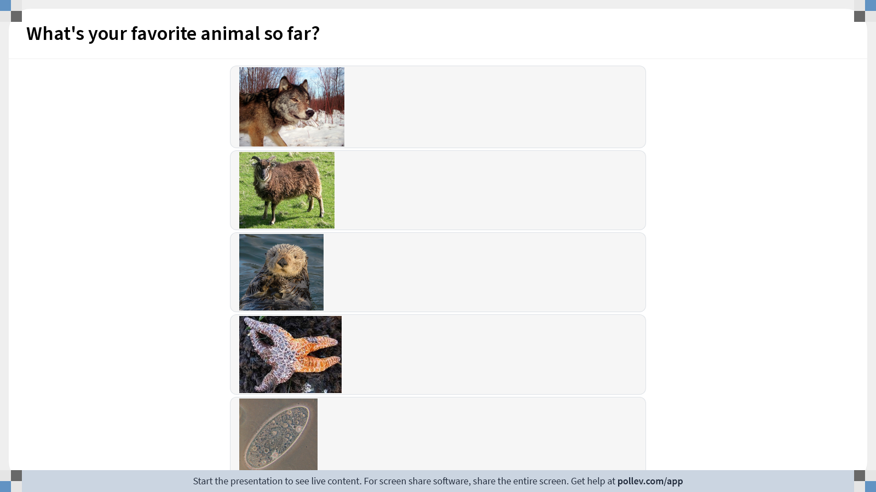
Notes:
Do not modify the notes in this section to avoid tampering with the Poll Everywhere activity. More info at polleverywhere.com/support What's your favorite animal so far?
https://www.polleverywhere.com/multiple_choice_polls/lwi7wQ72SqczqfzTj6Ob4?display_state=instructions&activity_state=opened&state=opened&flow=Engagement&onscreen=persist

Slide 2
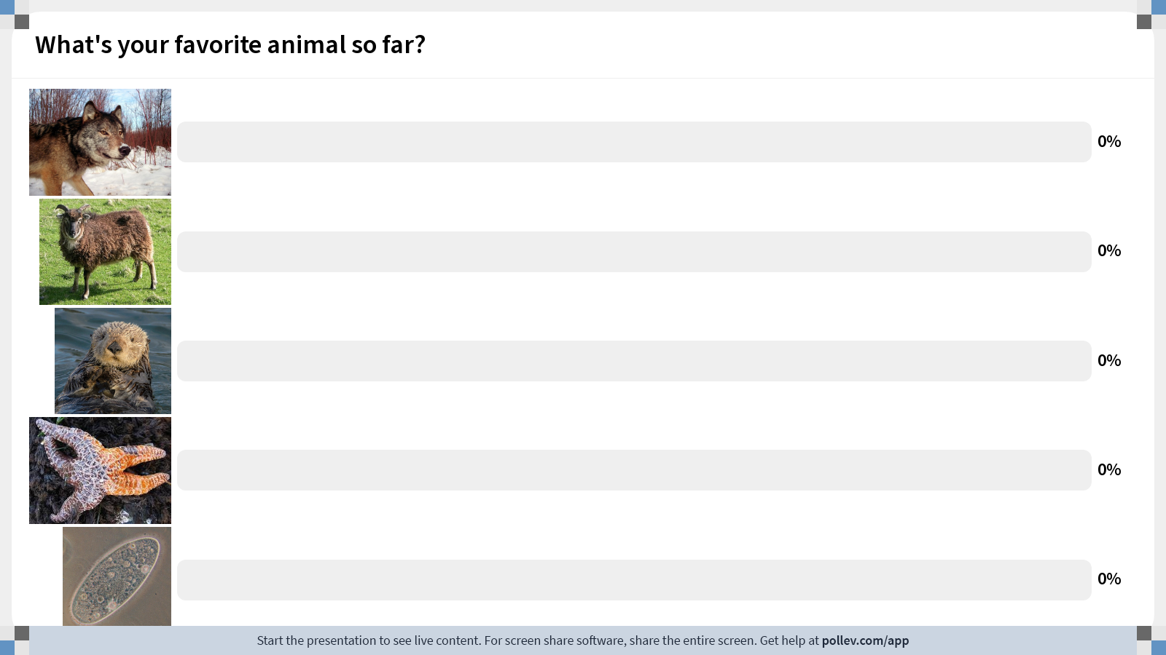
Notes:
Do not modify the notes in this section to avoid tampering with the Poll Everywhere activity. More info at polleverywhere.com/support What's your favorite animal so far?
https://www.polleverywhere.com/multiple_choice_polls/lwi7wQ72SqczqfzTj6Ob4?display_state=chart&activity_state=opened&state=opened&flow=Engagement&onscreen=persist

Slide 3
Notes:
Do not modify the notes in this section to avoid tampering with the Poll Everywhere activity. More info at polleverywhere.com/support What's your favorite animal so far?
https://www.polleverywhere.com/multiple_choice_polls/lwi7wQ72SqczqfzTj6Ob4?display_state=chart&activity_state=closed&state=closed&flow=Engagement&onscreen=persist

Slide 4
Fundamentals of Ecology
Week 8, Ecology Lecture 5
Cara Brook
February 20, 2024

Slide 5
Let’s recap a bit!
Interspecies Dynamics
The Lotka-Volterra competition model describes a minimum of two interacting species whose populations are regulated both by intra- and interspecific competition for limited resources.
We can draw the nullclines (or zero-growth isoclines) of this model. These lines describe the conditions under which the population size of one of the two species is at equilibrium (i.e. not changing).
The four equilibria of the system give the conditions under which the population size of neither species is changing. Under certain parameter conditions, we can find an equilibrium in which the two species demonstrate stable coexistence.
We can determine the stability of the system using vector addition on the nullcline planes.

Slide 6
Let’s recap a bit!
Interspecies Dynamics
The Lotka-Volterra competition model describes a minimum of two interacting species whose populations are regulated both by intra- and interspecific competition for limited resources.
We can draw the nullclines (or zero-growth isoclines) of this model. These lines describe the conditions under which the population size of one of the two species is at equilibrium (i.e. not changing).
The four equilibria of the system give the conditions under which the population size of neither species is changing. Under certain parameter conditions, we can find an equilibrium in which the two species demonstrate stable coexistence.
We can determine the stability of the system using vector addition on the nullcline planes.

Slide 7
Let’s recap a bit!
Interspecies Dynamics
The Lotka-Volterra competition model describes a minimum of two interacting species whose populations are regulated both by intra- and interspecific competition for limited resources.
We can draw the nullclines (or zero-growth isoclines) of this model. These lines describe the conditions under which the RATE of change for one species population is not changing.
The four equilibria of the system give the conditions under which the population size of neither species is changing. Under certain parameter conditions, we can find an equilibrium in which the two species demonstrate stable coexistence.
We can determine the stability of the system using vector addition on the nullcline planes.

Slide 8
Let’s recap a bit!
Interspecies Dynamics
The Lotka-Volterra competition model describes a minimum of two interacting species whose populations are regulated both by intra- and interspecific competition for limited resources.
We can draw the nullclines (or zero-growth isoclines) of this model. These lines describe the conditions under which the RATE of change for one species population is not changing.
The four equilibria of the system give the conditions under which the rate of change is 0 for both species populations. Under certain parameter conditions, we can find an equilibrium in which the two species demonstrate stable coexistence.
We can determine the stability of the system using vector addition on the nullcline planes.

Slide 9
Let’s recap a bit!
Interspecies Dynamics
The Lotka-Volterra competition model describes a minimum of two interacting species whose populations are regulated both by intra- and interspecific competition for limited resources.
We can draw the nullclines (or zero-growth isoclines) of this model. These lines describe the conditions under which the RATE of change for one species population is not changing.
The four equilibria of the system give the conditions under which the rate of change is 0 for both species populations. Under certain parameter conditions, we can find an equilibrium in which the two species demonstrate stable coexistence.
We can determine the stability of the system using vector addition on the nullcline planes.

Slide 10
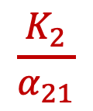
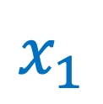
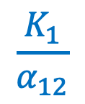
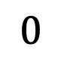

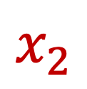
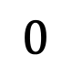
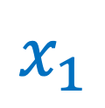
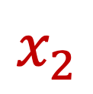
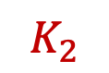
Let’s recap a bit!
Interspecies Dynamics
$$\frac{K_{1}}{α_{12}}$$
$$x_{2}$$
$$x_{2}$$
$$K_{2}$$
$$0$$
$$x_{1}$$
$$0$$
$$x_{1}$$
$$K_{1}$$
$$\frac{K_{2}}{α_{21}}$$

Slide 11
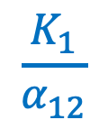
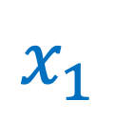
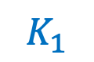

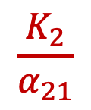
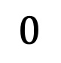
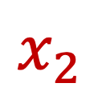
Let’s recap a bit!
Interspecies Dynamics
$$x_{2}$$
$$\frac{K_{1}}{α_{12}}$$
$$K_{2}$$
$$0$$
$$K_{1}$$
$$\frac{K_{2}}{α_{21}}$$
$$x_{1}$$

Slide 12
Let’s recap a bit!
Interspecies Dynamics
There are four possible outcomes of competition that can be observed from drawing the nullclines of the system.

Slide 13
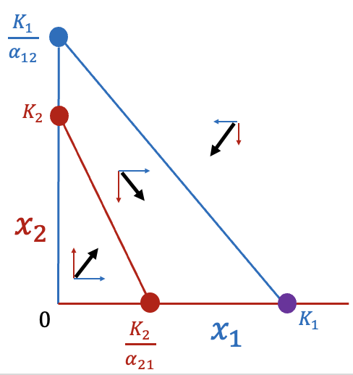
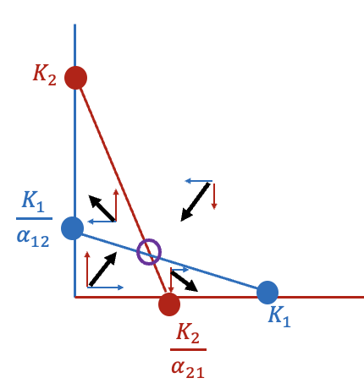
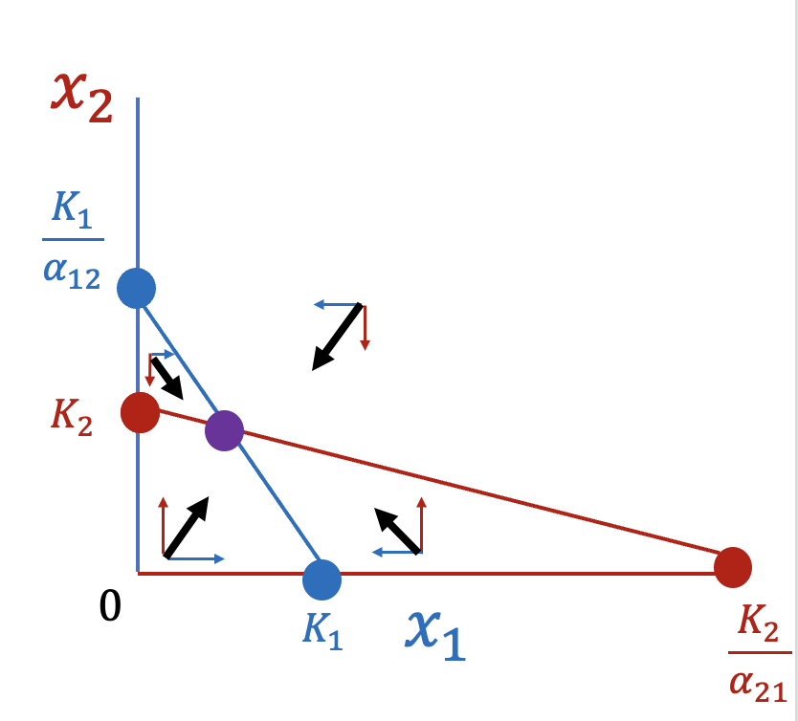
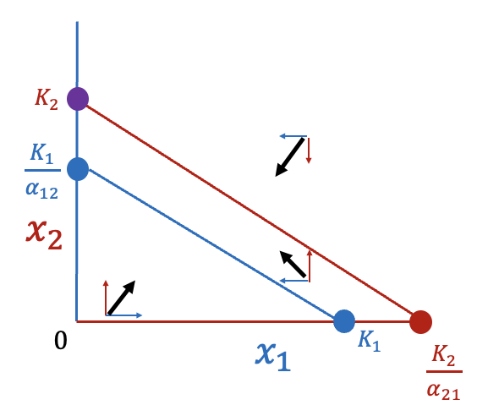



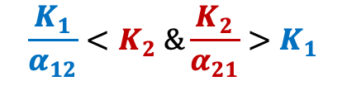
Let’s recap a bit!
Interspecies Dynamics
There are four possible outcomes of competition that can be observed from drawing the nullclines of the system.
Case 1: Stable coexistence
Case 2: Spp. 1 wins
Case 3: Spp. 2 wins
Case 4: Precedence
$$\frac{K_{1}}{α_{12}}>K_{2} \&\frac{K_{2}}{α_{21}}>K_{1}$$
$$\frac{K_{1}}{α_{12}}<K_{2} \&\frac{K_{2}}{α_{21}}<K_{1}$$
$$\frac{K_{1}}{α_{12}}<K_{2} \&\frac{K_{2}}{α_{21}}>K_{1}$$
$$\frac{K_{1}}{α_{12}}<K_{2} \&\frac{K_{2}}{α_{21}}>K_{1}$$
$${(α_{12}∗ α}_{21}<1)$$
$${(α_{12}∗α}_{21}>1)$$

Slide 14
Let’s recap a bit!
Interspecies Dynamics
There are four possible outcomes of competition that can be observed from drawing the nullclines of the system.
Case 1: Stable coexistence
Stable coexistence is possible when intraspecies competitive interactions are greater than interspecies interactions.
$$\frac{K_{1}}{α_{12}}>K_{2} \&\frac{K_{2}}{α_{21}}>K_{1}$$
$${(α_{12}∗ α}_{21}<1)$$

Slide 15
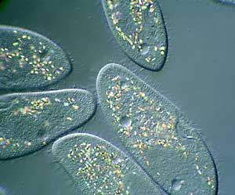
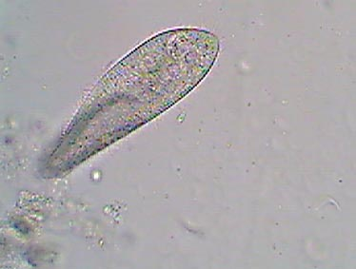
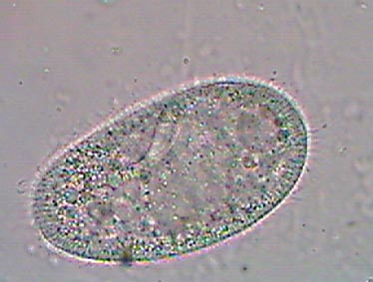
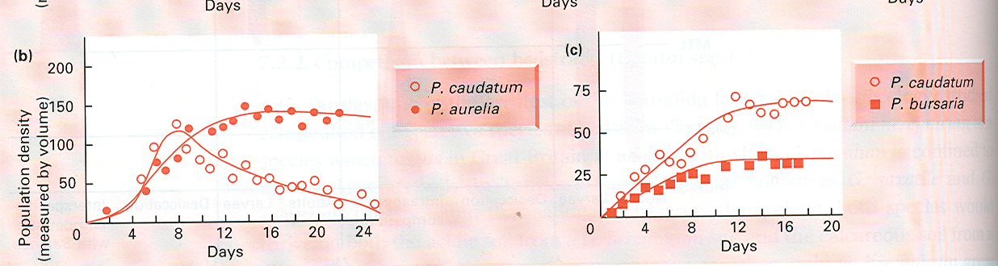
Gause’s experiments:
Competitive exclusion was observed:
Coexistence was observed:
Paramecium aurelia
Paramecium caudatum
Paramecium caudatum
Paramecium bursaria
Species coexisted below each species’ respective individual carrying capacity.
The two coexisting species were largely partitioned in space. P. bursaria ate yeast at the bottom and P. caudatum consumed bacteria suspended in the medium.
Gause 1934. J Experimental Biology.
Gause 1935. Science.
Notes:
Gause, Soviet biologist who experimentally demonstrated competitive exclusion in Lotka Volterra
In paramecium (eukaryotic, unicellular ciliates)

Slide 16
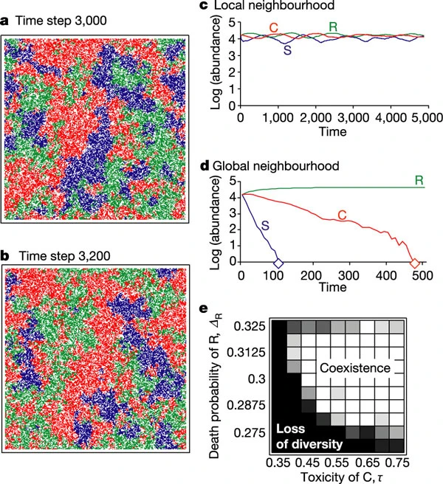
Sometimes stochasticity and space are all you need to ensure coexistence in a competitive environment
Kerr et al. modeled a community of 3 strains of E. coli with overlapping resource requirements (C,R, and S), occupying distinct spatial patches in a metapopulation.
They produced simulations allowing for a perfectly mixed population (global neighborhood), or a population in which dispersal (mixing) happened only locally. allowed to disperse only locally.
Local interactions allowed for the coexistence of all three strains (in theory). Experimentally?
Kerr et al. 2002. Nature.
Notes:
(remember metapopulations!

Slide 17
Sometimes stochasticity and space are all you need to ensure coexistence in a competitive environment
Kerr et al. modeled a community of 3 strains of E. coli with overlapping resource requirements (C,R, and S), occupying distinct spatial patches in a metapopulation.
They produced simulations allowing for a perfectly mixed population (global neighborhood), or a population in which dispersal (mixing) happened only locally.
Local interactions allowed for the coexistence of all three strains (in theory). Experimentally?
Kerr et al. 2002. Nature.
Notes:
(remember metapopulations!

Slide 18
Sometimes stochasticity and space are all you need to ensure coexistence in a competitive environment
The authors modeled a community of 3 strains of E. coli with overlapping resource requirements (C,R, and S), occupying distinct spatial patches in a metapopulation.
They produced simulations allowing for a perfectly mixed population (global neighborhood), or a population in which dispersal (mixing) happened only locally.
Local interactions allowed for the coexistence of all three strains (in theory). What about experimentally?
Kerr et al. 2002. Nature.
Notes:
(remember metapopulations!

Slide 19
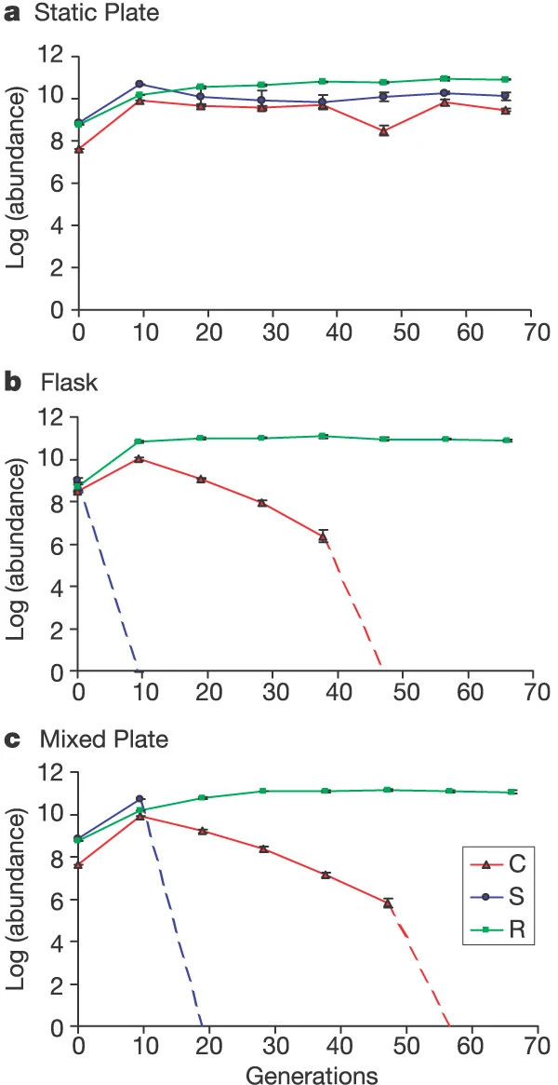
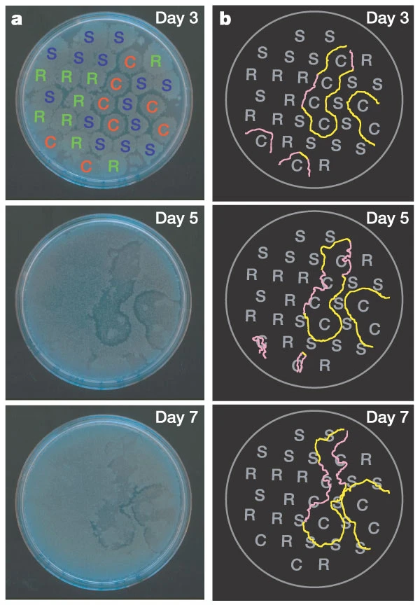
Sometimes adding stochasticity and space (remember metapopulations!) is all you need to ensure coexistence!
Kerr et al. 2002. Nature.

Slide 20
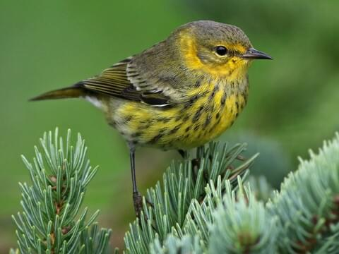
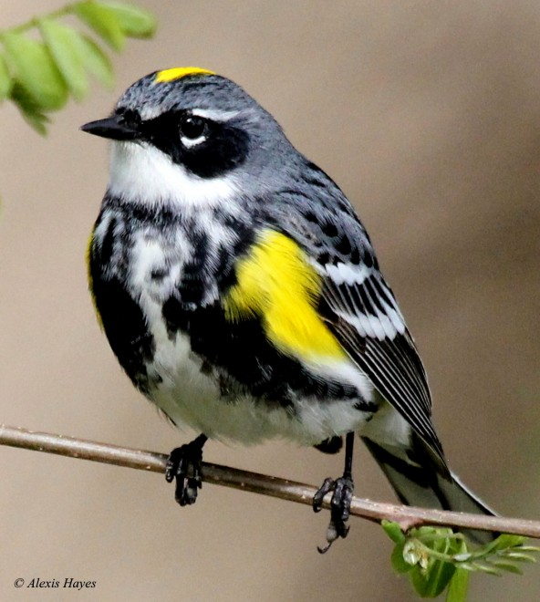
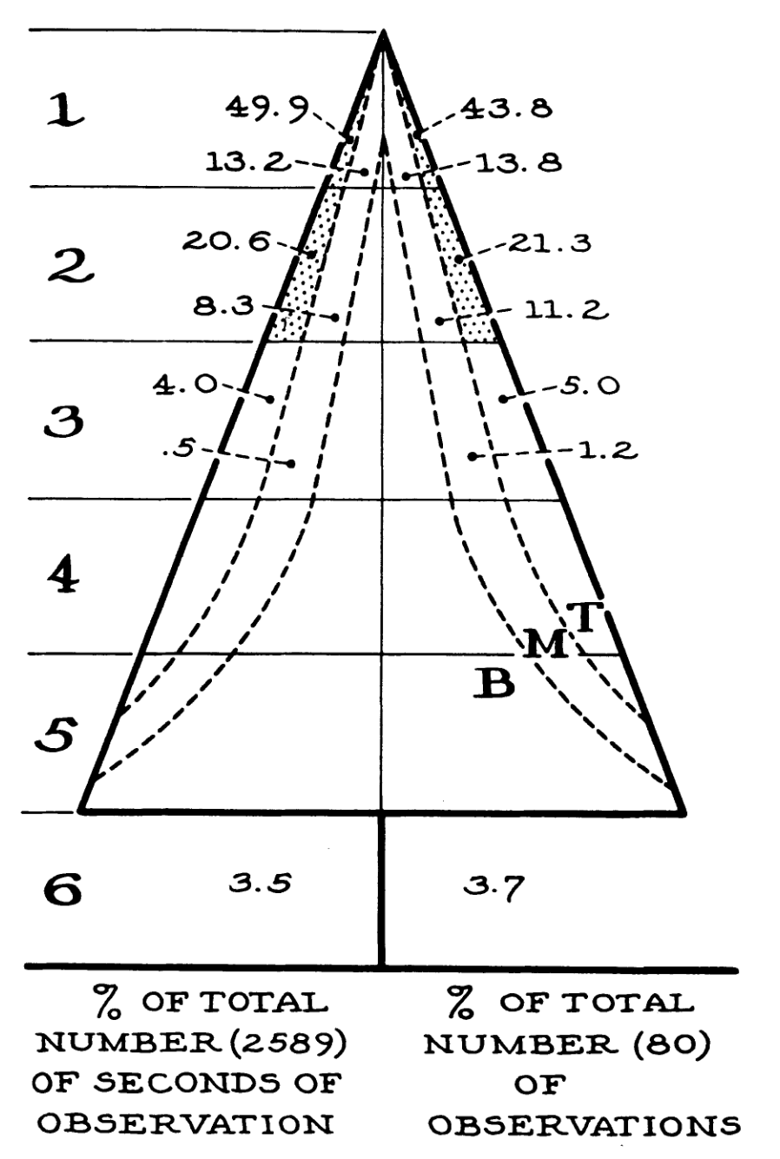
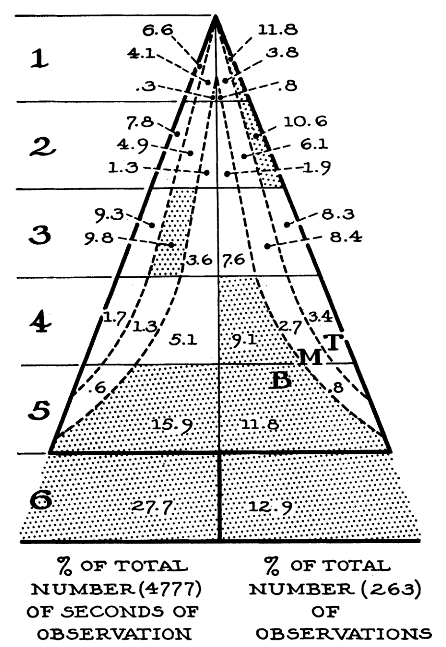
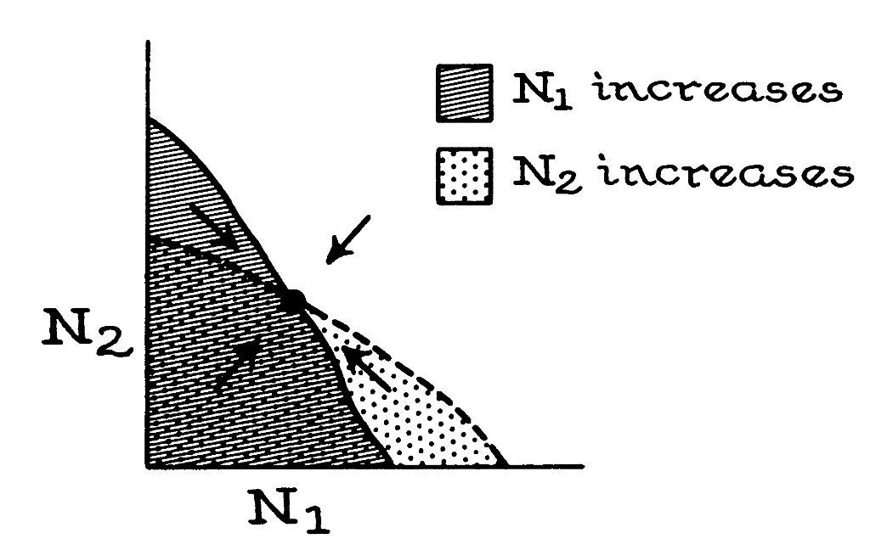
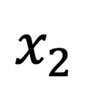
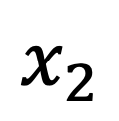
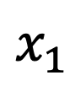
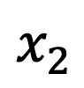
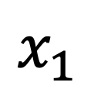
Niche partitioning enables organisms to avoid competitive exclusion
Cape May Warbler
Myrtle Warbler
Niche: a match of a species to a specific environmental condition
$$x_{2}$$
$$x_{1}$$
$$x_{2}$$
$$x_{2}$$
$$x_{1}$$
MacArthur 1968. Ecology.
Notes:
5 species of warbler

Slide 21
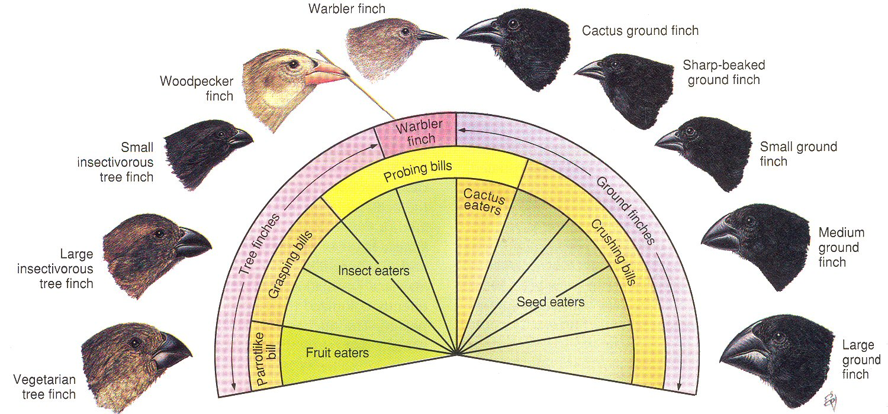

Niche partitioning enables organisms to avoid competitive exclusion
Character displacement: similar species that live in the same geographical region and occupy similar niches differentiate in order to minimize niche overlap and avoid competitive exclusion.
Grant & Grant 2006. Science.

Slide 22
Niche partitioning enables organisms to avoid competitive exclusion
Character displacement: similar species that live in the same geographical region and occupy similar niches differentiate in order to minimize niche overlap and avoid competitive exclusion.
Species A
Species B
Use
Use
Competition
Resource
Grant & Grant 2006. Science.
When niches overlap, competition results

Slide 23
Niche partitioning enables organisms to avoid competitive exclusion
Character displacement: similar species that live in the same geographical region and occupy similar niches differentiate in order to minimize niche overlap and avoid competitive exclusion.
Species A
Species B
Use
Use
Resource
Grant & Grant 2006. Science.
Character displacement forces niches apart.

Slide 24
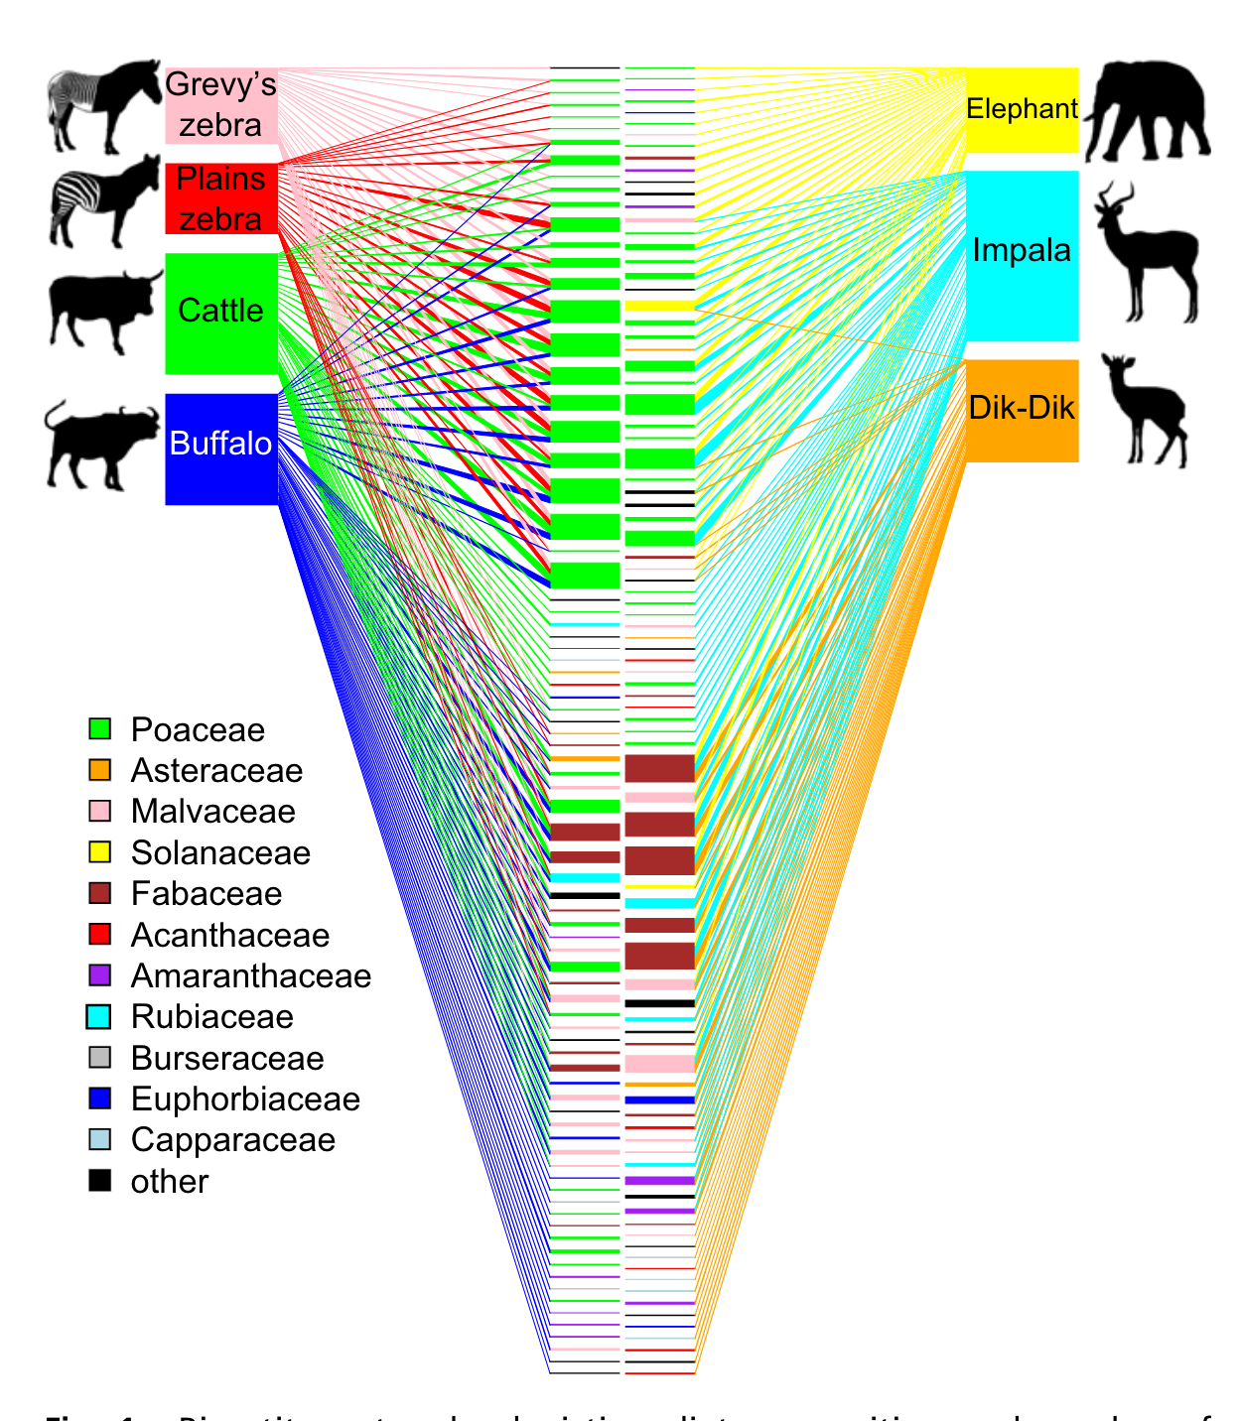
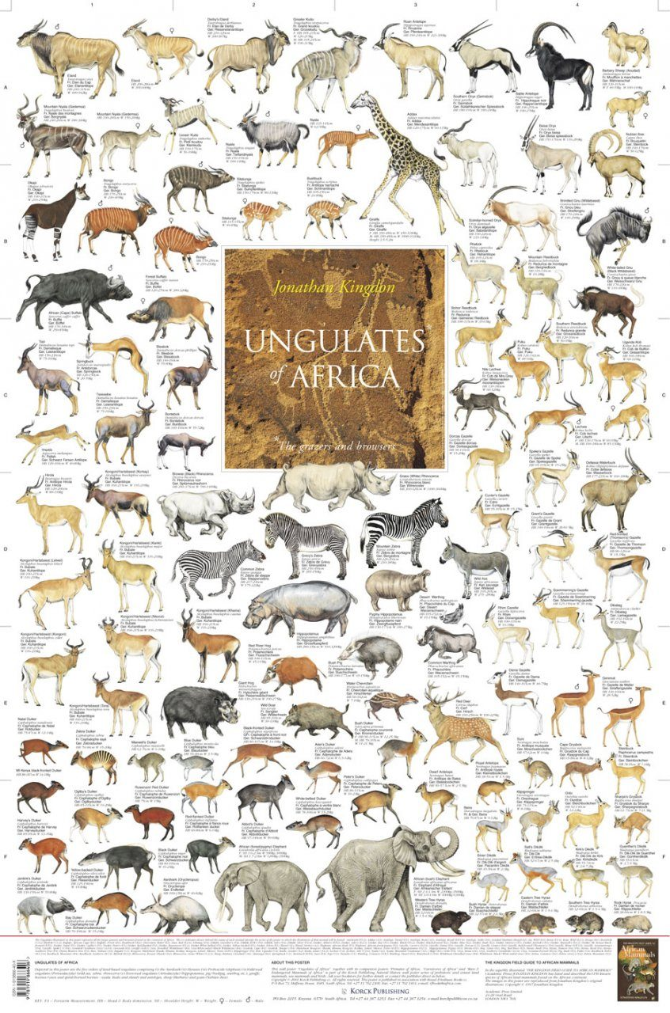
Niche partitioning enables organisms to avoid competitive exclusion
Often 10-25 large mammalian herbivores coexisting in the same African savanna!
Kartzinel et al. 2015. PNAS.

Slide 25
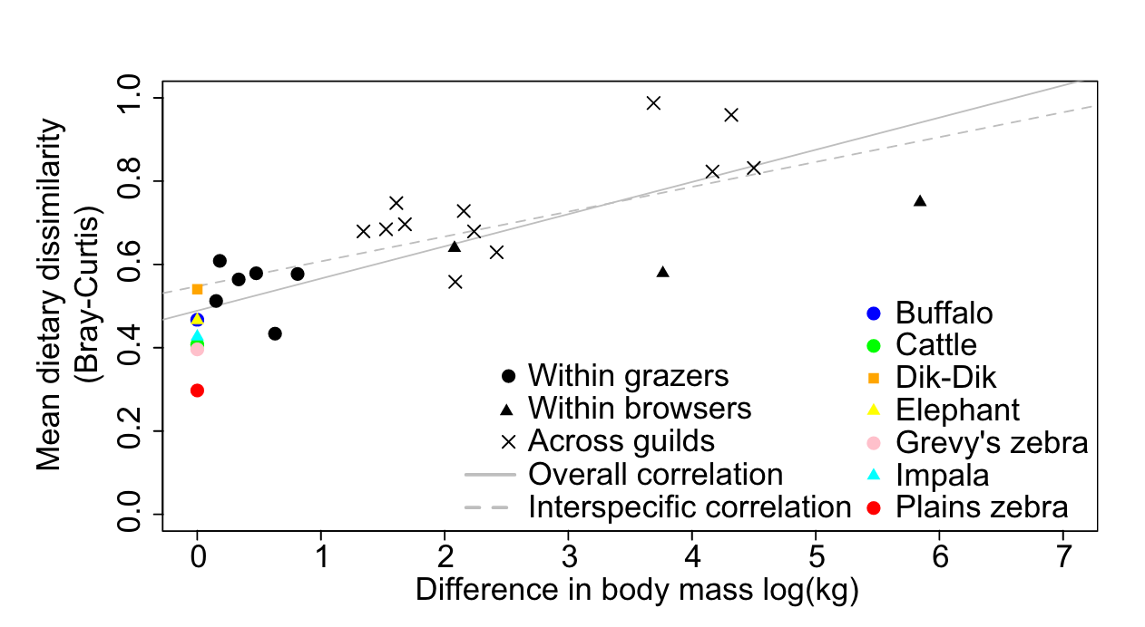
Niche partitioning enables organisms to avoid competitive exclusion
Dietary overlap is higher in similar-sized mammals
Kartzinel et al. 2015. PNAS.

Slide 26
Consumer resource partitioning in the African savanna
Grazer
(generalist)
Browser
(specialist)
Kartzinel et al. 2015. PNAS.

Slide 27
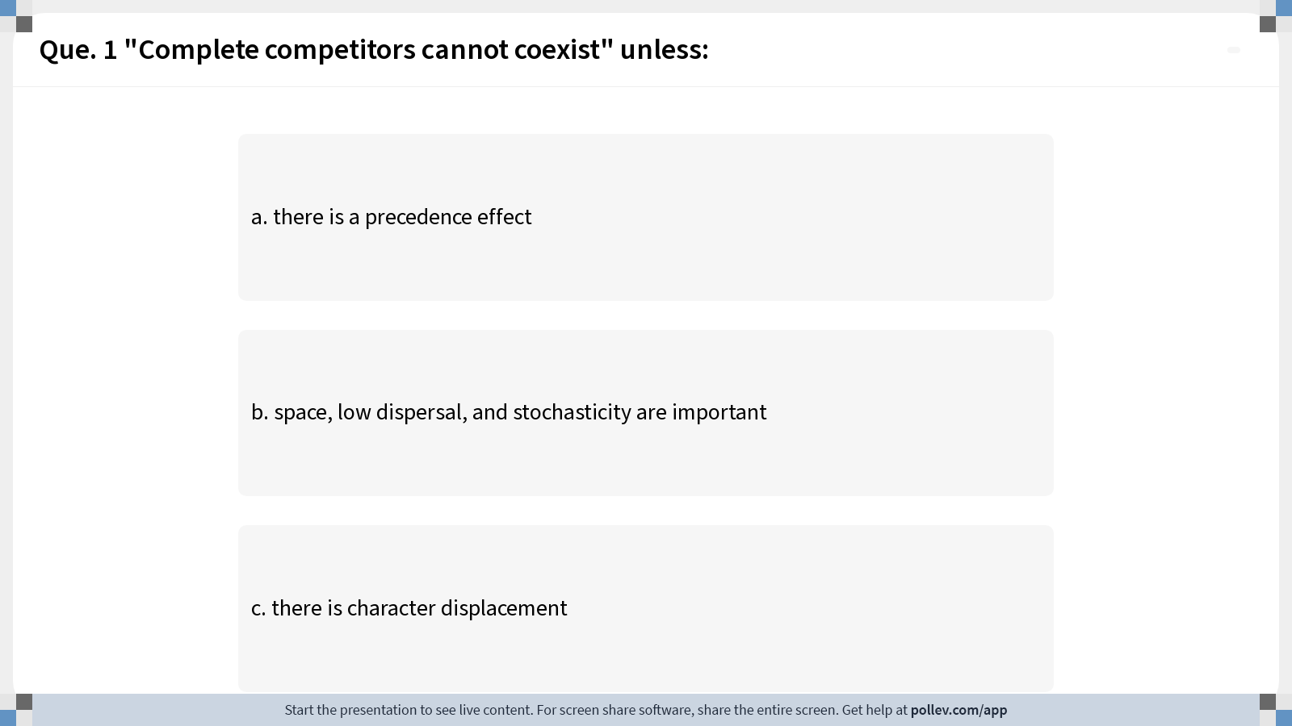
Notes:
Do not modify the notes in this section to avoid tampering with the Poll Everywhere activity. More info at polleverywhere.com/support Que. 1 "Complete competitors cannot coexist" unless:
https://www.polleverywhere.com/multiple_choice_polls/BgMMKj22hmqEgIBzoysuF?display_state=instructions&activity_state=opened&state=opened&flow=Instructor&onscreen=persist

Slide 28
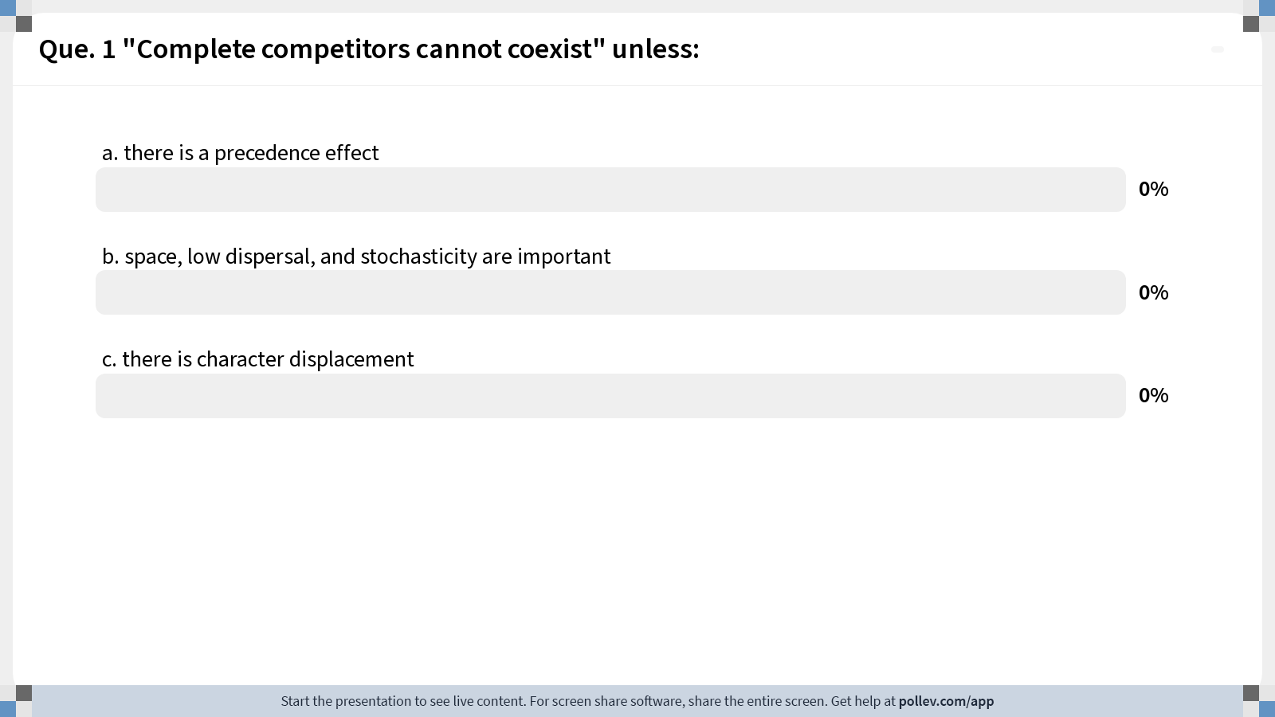
Notes:
Do not modify the notes in this section to avoid tampering with the Poll Everywhere activity. More info at polleverywhere.com/support Que. 1 "Complete competitors cannot coexist" unless:
https://www.polleverywhere.com/multiple_choice_polls/BgMMKj22hmqEgIBzoysuF?display_state=chart&activity_state=closed&state=closed&flow=Instructor&onscreen=persist

Slide 29
Notes:
Do not modify the notes in this section to avoid tampering with the Poll Everywhere activity. More info at polleverywhere.com/support Que. 1 "Complete competitors cannot coexist" unless:
https://www.polleverywhere.com/multiple_choice_polls/BgMMKj22hmqEgIBzoysuF?display_state=chart&activity_state=closed&display=correctness&state=closed&flow=Instructor&onscreen=persist

Slide 30
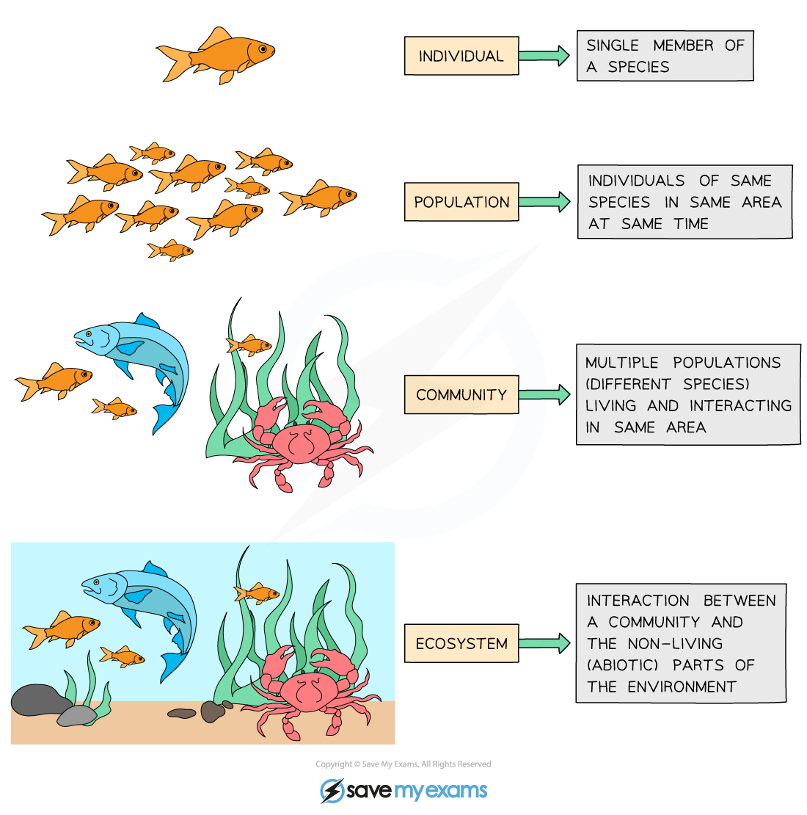
Community = interacting populations of different species
individual
population
fish
(x)
metapopulation
shark
(y)
community
How does fish abundance vary with changes in shark abundance?
ecosystem

Slide 31
Community = interacting populations of different species
individual
population
$$α_{12}$$
$$r_{1}$$
metapopulation
Fish A
(x₁)
Fish B
(x₂)
$$r_{2}$$
community
$$α_{21}$$
How does the abundance of fish species A vary with changes in the abundance of fish species B?
ecosystem

Slide 32
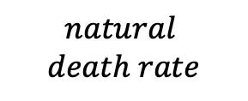
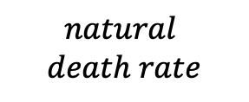
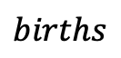
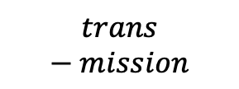

Community = interacting populations of different species
individual
population
$$births$$
Healthy
Fish
(susceptible)
$$trans−mission$$
Sick Fish (infected)
$$disease$$
$$death rate$$
metapopulation
$$natural$$
$$death rate$$
$$natural$$
$$death rate$$
community
How does the abundance of fish change based on infection with Mycobacterium marinum (wasting disease)?
ecosystem

Slide 33
Community = interacting populations of different species
$$births$$
Healthy
Fish
(susceptible)
$$trans−mission$$
Sick Fish (infected)
$$disease$$
$$death rate$$
$$natural$$
$$death rate$$
$$natural$$
$$death rate$$
How does the abundance of fish change based on infection with Mycobacterium marinum (wasting disease)?

Slide 34
Species can interact in several distinct ways.
Community = interacting populations of different species
$$births$$
Mutualism – both species benefit
Commensalism – one species benefits, the other is unaffected
Predation – one species benefits, the other is harmed (eaten!)
Competition – two species compete for the same limiting resource, both harmed by the interaction
Direct = wolves and coyote at a moose carcass
Indirect = diurnal cheetah, nocturnal leopard at a giraffe carcass
Parasitism – one species (the parasite) lives in or on the other species (the host)
Healthy
Fish
(susceptible)
$$trans−mission$$
Sick Fish (infected)
$$disease$$
$$death rate$$
$$natural$$
$$death rate$$
$$natural$$
$$death rate$$
How does the abundance of fish change based on infection with Mycobacterium marinum (wasting disease)?

Slide 35





Each box is a distinct population! When we model these populations, everyone in the box is considered the same. In a continuous time model (ODE), each box would get its own differential equation!
Population Biology
$$births$$
Healthy
Fish
(susceptible)
$$trans−mission$$
Sick Fish (infected)
$$disease$$
$$death rate$$
$$natural$$
$$death rate$$
$$natural$$
$$death rate$$
How does the abundance of fish change based on infection with Mycobacterium marinum (wasting disease)?

Slide 36
Each box is a distinct population! When we model these populations, everyone in the box is considered the same. In a continuous time model (ODE), each box would get its own differential equation!
Population Biology
$$births$$
Healthy
Fish
(susceptible)
$$trans−mission$$
Sick Fish (infected)
$$disease$$
$$death rate$$
$$natural$$
$$death rate$$
$$natural$$
$$death rate$$
How does the abundance of fish change based on infection with Mycobacterium marinum (wasting disease)?

Slide 37
Each box is a distinct population! When we model these populations, everyone in the box is considered the same. In a continuous time model (ODE), each box would get its own differential equation!
Population Biology
$$births$$
Healthy
Fish
(susceptible)
$$trans−mission$$
Sick Fish (infected)
$$disease$$
$$death rate$$
$$natural$$
$$death rate$$
$$natural$$
$$death rate$$
How does the abundance of fish change based on infection with Mycobacterium marinum (wasting disease)?

Slide 38
Each box is a distinct population! When we model these populations, everyone in the box is considered the same. In a continuous time model (ODE), each box would get its own differential equation!
Population Biology
$$births$$
Solid lines are processes by which individuals in each population move between boxes.
Dashed lines are influences of populations on rates (transmission is higher when there are more sick fish)
Healthy
Fish
(susceptible)
$$trans−mission$$
Sick Fish (infected)
$$disease$$
$$death rate$$
$$natural$$
$$death rate$$
$$natural$$
$$death rate$$
How does the abundance of fish change based on infection with Mycobacterium marinum (wasting disease)?

Slide 39


Each box is a distinct population! When we model these populations, everyone in the box is considered the same. In a continuous time model (ODE), each box would get its own differential equation!
Population Biology
$$births$$
Solid lines are processes by which individuals in each population move between boxes.
Dashed lines are influences of populations on rates (transmission is higher when there are more sick fish)
Healthy
Fish
(susceptible)
Sick Fish (infected)
$$disease$$
$$death rate$$
$$trans−mission$$
$$natural$$
$$death rate$$
$$natural$$
$$death rate$$
How does the abundance of fish change based on infection with Mycobacterium marinum (wasting disease)?

Slide 40





Population Biology
$$births$$
How does the abundance of fish change based on infection with Mycobacterium marinum (wasting disease)?
Healthy
Fish
(susceptible)
$$trans−mission$$
Sick Fish (infected)
$$disease$$
$$death rate$$
$$natural$$
$$death rate$$
$$natural$$
$$death rate$$
In disease ecology, we model populations based on their infection status.

Slide 41
Population Biology
$$births$$
How does the abundance of fish change based on infection with Mycobacterium marinum (wasting disease)?
Healthy
Fish
(susceptible)
$$trans−mission$$
Sick Fish (infected)
$$disease$$
$$death rate$$
$$natural$$
$$death rate$$
$$natural$$
$$death rate$$
Previously, we modeled populations of different species, or of distinct life history classes within a species.
In disease ecology, we model populations based on their infection status.

Slide 42
Population Biology
Conservation Biology
Disease Ecology
Goal:
protect populations from extinction
Concept:
Minimum Viable Population size (MVP)
Approach:
protected area reserves
Goal:
protect populations from disease via pathogen extinction
Concept:
Critical Community Size (CCS)
Approach:
sanitation
vaccination

Slide 43
Population Biology
Conservation Biology
Disease Ecology
Goal:
protect populations from extinction
Concept:
Minimum Viable Population size (MVP)
Approach:
protected area reserves
Goal:
protect populations from disease via pathogen extinction
Concept:
Critical Community Size (CCS)
Approach:
sanitation
vaccination

Slide 44
Population Biology
Conservation Biology
Disease Ecology
Goal:
protect populations from extinction
Concept:
Minimum Viable Population size (MVP)
Approach:
protected area reserves
Goal:
protect populations from disease via pathogen extinction
Concept:
Critical Community Size (CCS)
Approach:
sanitation
vaccination

Slide 45
Population Biology
Conservation Biology
Disease Ecology
Goal:
protect populations from extinction
Concept:
Minimum Viable Population size (MVP)
Approach:
protected area reserves
Goal:
protect populations from disease via pathogen extinction
Concept:
Critical Community Size (CCS)
Approach:
sanitation
vaccination

Slide 46
Population Biology
Conservation Biology
Disease Ecology
Goal:
protect populations from extinction
Concept:
Minimum Viable Population size (MVP)
Approach:
protected area reserves
Goal:
protect populations from disease via pathogen extinction
Concept:
Critical Community Size (CCS)
Approach:
sanitation
vaccination

Slide 47
Population Biology
Conservation Biology
Disease Ecology
Goal:
protect populations from extinction
Concept:
Minimum Viable Population size (MVP)
Approach:
protected area reserves
Goal:
protect populations from disease via pathogen extinction
Concept:
Critical Community Size (CCS)
Approach:
sanitation
vaccination

Slide 48
Population Biology
Conservation Biology
Disease Ecology
Goal:
protect populations from extinction
Concept:
Minimum Viable Population size (MVP)
Approach:
protected area reserves
Goal:
protect populations from disease via pathogen extinction
Concept:
Critical Community Size (CCS)
Approach:
sanitation
vaccination

Slide 49


December 16, 2022 E2M2.org
E²M²: Ecological and Epidemiological Modeling in Madagascar
Notes:
I unite these every year in a simple programming and modeling course (E2M2) which I teach for students in Madagascar

Slide 50



Parasites and Pathogens
Parasite: an organism that lives in or on another organism and benefits at the expense of others.
Ex: helminths (parasitic worms: tapeworms, roundworms, hookworms), ectoparasites (ticks, fleas)
Notes:
Parasite isPathogen

Slide 51
Parasites and Pathogens
Parasite: an organism that lives in or on another organism and benefits at the expense of others.
Ex: helminths (parasitic worms: tapeworms, roundworms, hookworms), ectoparasites (ticks, fleas)
Pathogen: a microorganism that can cause disease
Ex: bacterium, virus, protozoan
Notes:
Parasite isPathogen

Slide 52

Parasites and Pathogens
Parasite: an organism that lives in or on another organism and benefits at the expense of others.
Ex: helminths (parasitic worms: tapeworms, roundworms, hookworms), ectoparasites (ticks, fleas)
Pathogen: a microorganism that can cause disease
Ex: bacterium, virus, protozoan
Pathogen: Yersinia pestis
Disease: Plague
Notes:
Parasite isPathogen

Slide 53

Parasites and Pathogens
Parasite: an organism that lives in or on another organism and benefits at the expense of others.
Ex: helminths (parasitic worms: tapeworms, roundworms, hookworms), ectoparasites (ticks, fleas)
Pathogen: a microorganism that can cause disease
Ex: bacterium, virus, protozoan
Pathogen: Yersinia pestis
Disease: Plague
Pathogen: SARS-CoV-2
Disease: COVID-19
Notes:
Parasite isPathogen

Slide 54

Parasites and Pathogens
Parasite: an organism that lives in or on another organism and benefits at the expense of others.
Ex: helminths (parasitic worms: tapeworms, roundworms, hookworms), ectoparasites (ticks, fleas)
Pathogen: a microorganism that can cause disease
Ex: bacterium, virus, protozoan
Pathogen: Yersinia pestis
Disease: Plague
Pathogen: Plasmodium falciparum, P. vivax, P. malariae, P. ovale, P. knowlesi
Disease: malaria
Pathogen: SARS-CoV-2
Disease: COVID-19
Notes:
Parasite isPathogen

Slide 55


Parasites and Pathogens
Parasite: an organism that lives in or on another organism and benefits at the expense of others.
Ex: helminths (parasitic worms: tapeworms, roundworms, hookworms), ectoparasites (ticks, fleas)
Pathogen: a microorganism that can cause disease
Ex: bacterium, virus, protozoan
Host: the organism on/in which the parasite/pathogen lives
Ex: Soay sheep, grapes
Notes:
Parasite isPathogen

Slide 56

Parasites and Pathogens
Parasite: an organism that lives in or on another organism and benefits at the expense of others.
Ex: helminths (parasitic worms: tapeworms, roundworms, hookworms), ectoparasites (ticks, fleas)
Pathogen: a microorganism that can cause disease
Ex: bacterium, virus, protozoan
Host: the organism on/in which the parasite/pathogen lives
Ex: Soay sheep, grapes
Vector: an arthropod agent that carries and transmits a pathogen or parasite from host to host
Ex: mosquitoes, ticks, fleas
Notes:
Parasite isPathogen

Slide 57



We already know that parasites can play a role in regulating populations!
male juveniles with nematodes
male juveniles treated with antihelminthic
Soay Sheep of St. Kilda, Scotland
Gulland 1992. Parasitology.

Slide 58


Early work in red grouse experimentally demonstrated the power of parasites to regulate populations.
Hudson 1986. J Animal Ecology.
Hudson et al 1992. J Animal Ecology.
Hudson et al 1998. Science.

Slide 59

Notes:
Do not modify the notes in this section to avoid tampering with the Poll Everywhere activity. More info at polleverywhere.com/support Que 2: What factors do we know contribute to annual fluctuations in the population density of the Soay sheep of St Kilda?
https://www.polleverywhere.com/multiple_choice_polls/osKAQNV1jvXC5i2tDNfk3?display_state=instructions&activity_state=opened&state=opened&flow=Instructor&onscreen=persist

Slide 60

Notes:
Do not modify the notes in this section to avoid tampering with the Poll Everywhere activity. More info at polleverywhere.com/support Que 2: What factors do we know contribute to annual fluctuations in the population density of the Soay sheep of St Kilda?
https://www.polleverywhere.com/multiple_choice_polls/osKAQNV1jvXC5i2tDNfk3?display_state=chart&activity_state=closed&state=closed&flow=Instructor&onscreen=persist

Slide 61
Notes:
Do not modify the notes in this section to avoid tampering with the Poll Everywhere activity. More info at polleverywhere.com/support Que 2: What factors do we know contribute to annual fluctuations in the population density of the Soay sheep of St Kilda?
https://www.polleverywhere.com/multiple_choice_polls/osKAQNV1jvXC5i2tDNfk3?display_state=chart&activity_state=closed&display=correctness&state=closed&flow=Instructor&onscreen=persist

Slide 62




Early work in red grouse experimentally demonstrated the power of parasites to regulate populations.
Higher burden of the intestinal strongyle worm, Trichostrongylus tenuis, both reduces breeding success and increases mortality in red grouse.
Hudson 1986. J Animal Ecology.
Hudson et al 1992. J Animal Ecology.

Slide 63

Worms were hypothesized to be responsible for the observed population cycles in ‘bag data’ from northern England.
Hudson et al 1998. Science.

Slide 64
Deworming eliminated population cycles to prove this effect!
Hudson et al 1998. Science.

Slide 65
Parasites and pathogens have also shaped human history.
Notes:
Parasite isPathogen

Slide 66
Parasites and pathogens have also shaped human history.
But we have not always known they were responsible for disease!
Notes:
Parasite isPathogen

Slide 67
Parasites and pathogens have also shaped human history.
But we have not always known they were responsible for disease!
Four Humors: Hippocrates (c. 400 BC) wrote that disease results from an imbalance of the four humors
Notes:
Parasite isPathogen

Slide 68

Parasites and pathogens have also shaped human history.
But we have not always known they were responsible for disease!
Four Humors: Hippocrates (c. 400 BC) wrote that disease results from an imbalance of the four humors
Miasmatic Theory: Extension of Hippocrates that lasted through the 1800s – idea that disease was caused by bad air. Popularized by Florence Nightengale
Notes:
Parasite isPathogen

Slide 69

Parasites and pathogens have also shaped human history.
But we have not always known they were responsible for disease!
Four Humors: Hippocrates (c. 400 BC) wrote that disease results from an imbalance of the four humors
Miasmatic Theory: Extension of Hippocrates that lasted through the 1800s – idea that disease was caused by bad air.
Popularized by Florence Nightengale
Germ Theory of Disease: Idea that disease results from germs
Leuwenhoek’s microscope (1675)
Koch’s postulates (1890)
Notes:
Parasite isPathogen

Slide 70

Parasites and pathogens have also shaped human history.
But we have not always known they were responsible for disease!
Four Humors: Hippocrates (c. 400 BC) wrote that disease results from an imbalance of the four humors
Miasmatic Theory: Extension of Hippocrates that lasted through the 1800s – idea that disease was caused by bad air.
Popularized by Florence Nightengale
Germ Theory of Disease: Idea that disease results from germs
Leuwenhoek’s microscope (1675)
Koch’s postulates (1890)
Classic epidemiology
Risk factors for disease = John Snow (1854)
Notes:
Parasite isPathogen

Slide 71

Parasites and pathogens have also shaped human history.
Plague of Justinian (541-549 AD)
First historically recorded pandemic of Yersinia pestis
Launched the ‘first plague pandemic’ resulting in the deaths of 15-100 million people, 25-60% of Europe’s population at the time
Notes:
Parasite is an organism that lives in or on another organism and benefits at the expense of others.
Pathogen

Slide 72

Parasites and pathogens have also shaped human history.
Plague of Justinian (541-549 AD)
Black Death (1346-1353 AD)
Most fatal pandemic in human history, resulting in deaths of 75-200 million people
Killed 30-60% of Europe’s population at the time; 17-54% of global population
Notes:
By Flappiefh - Own work from:Natural Earth ;The origin and early spread of the Black Death in Italy: first evidence of plague victims from 14th-century Liguria (northern Italy) maps by O.J. Benedictow., CC BY-SA 4.0, https://commons.wikimedia.org/w/index.php?curid=66468361

Slide 73

Parasites and pathogens have also shaped human history.
Plague of Justinian (541-549 AD)
Black Death (1346-1353 AD)
Cocoliztli (1545-1548)
Pathogen still unknown! Maybe viral hemorrhagic fever, maybe bacterium
Killed 80% of the population of Mexico
Notes:
By Flappiefh - Own work from:Natural Earth ;The origin and early spread of the Black Death in Italy: first evidence of plague victims from 14th-century Liguria (northern Italy) maps by O.J. Benedictow., CC BY-SA 4.0, https://commons.wikimedia.org/w/index.php?curid=66468361

Slide 74

Parasites and pathogens have also shaped human history.
Plague of Justinian (541-549 AD)
Black Death (1346-1353 AD)
Cocoliztli (1545-1548)
Spanish Influenza (1918-1920)
17-100 million deaths worldwide.
1-5% of global population
2nd-most devastating pandemic in history (after Black Death)
Notes:
The pandemic broke out near the end of World War I, when wartime censors in the belligerent countries suppressed bad news to maintain morale, but newspapers freely reported the outbreak in neutral Spain, creating a false impression of Spain as the epicenter and leading to the "Spanish flu" misnomer.[

Slide 75


Parasites and pathogens have also shaped human history.
Plague of Justinian (541-549 AD)
Black Death (1346-1353 AD)
Cocoliztli (1545-1548)
Spanish Influenza (1918-1920)
HIV (~1960-now)
>40 million deaths and counting
Prevalence still >20% in some countries in southern Africa

Slide 76

Parasites and pathogens have also shaped human history.
Plague of Justinian (541-549 AD)
Black Death (1346-1353 AD)
Cocoliztli (1545-1548)
Spanish Influenza (1918-1920)
HIV (~1960-now)
COVID-19 (2019-now)
~7-29 million deaths worldwide
~0.1-0.4% of population
Notes:
According to a UNAIDS dataset sourced from the World Bank, in 2019 the HIV prevalence rate for adults aged 15 to 49 was 27% in Eswatini (Swaziland), 25% in Lesotho, 25% in Botswana and 19% in South Africa.^{[1]}

Slide 77
Parasites and pathogens have also shaped human DNA.
Notes:
The way in which sickle cell protects against malaria is attributed to several different things. One of the more common explanations is that the sickle hemoglobin inhibits the plasmodium parasite from infecting the red blood cells which reduces the number of malaria parasites to infect the host. Another factor is the production of heme oxygenase-1 (HO-1) enzyme, which is highly present in the sickle hemoglobin. This enzyme produces carbon monoxide which has been proven to protect against cerebral malaria
Normally, a person inherits two copies of the gene that produces beta-globin, a protein needed to produce normal hemoglobin (hemoglobin A, genotype AA). A person with sickle cell trait inherits one normal allele and one abnormal allele encoding hemoglobin S (hemoglobin genotype AS)
The sickle cell trait can be used to demonstrate the concepts of co-dominance and incomplete dominance. An individual with the sickle cell trait shows incomplete dominance when the shape of the red blood cell is considered. This is because the sickling happens only at low oxygen concentrations. With regards to the actual concentration of hemoglobin in the circulating cells, the alleles demonstrate co-dominance as both 'normal' and mutant forms co-exist in the bloodstream. Thus it is an ambiguous condition showing both incomplete dominance and co-dominance
2021, there were an estimated 247 million cases of malaria worldwide.
The estimated number of malaria deaths stood at 619 000 in 2021.
The WHO African Region carries a disproportionately high share of the global malaria burden. In 2021, the region was home to 95% of malaria cases and 96% of malaria deaths. Children under 5 accounted for about 80% of all malaria deaths in the Region.

Slide 78

Parasites and pathogens have also shaped human DNA.
Sickle cell anemia
The HbS allele confers resistance to malaria but also results in sickle cell anemia when homozygous.
Natural selection has favored this trait in malaria-endemic regions of the planet.
As of 2021, WHO estimates 247 million malaria cases worldwide and >600,000 deaths, 95% in Africa.
Children <5 account for 80% of malaria deaths.
Piel et al 2010. Nature Communications.
Notes:
The way in which sickle cell protects against malaria is attributed to several different things. One of the more common explanations is that the sickle hemoglobin inhibits the plasmodium parasite from infecting the red blood cells which reduces the number of malaria parasites to infect the host. Another factor is the production of heme oxygenase-1 (HO-1) enzyme, which is highly present in the sickle hemoglobin. This enzyme produces carbon monoxide which has been proven to protect against cerebral malaria
Normally, a person inherits two copies of the gene that produces beta-globin, a protein needed to produce normal hemoglobin (hemoglobin A, genotype AA). A person with sickle cell trait inherits one normal allele and one abnormal allele encoding hemoglobin S (hemoglobin genotype AS)
The sickle cell trait can be used to demonstrate the concepts of co-dominance and incomplete dominance. An individual with the sickle cell trait shows incomplete dominance when the shape of the red blood cell is considered. This is because the sickling happens only at low oxygen concentrations. With regards to the actual concentration of hemoglobin in the circulating cells, the alleles demonstrate co-dominance as both 'normal' and mutant forms co-exist in the bloodstream. Thus it is an ambiguous condition showing both incomplete dominance and co-dominance
2021, there were an estimated 247 million cases of malaria worldwide.
The estimated number of malaria deaths stood at 619 000 in 2021.
The WHO African Region carries a disproportionately high share of the global malaria burden. In 2021, the region was home to 95% of malaria cases and 96% of malaria deaths. Children under 5 accounted for about 80% of all malaria deaths in the Region.

Slide 79


Parasites and pathogens have also shaped human DNA.
Duffy antigen
Modeled distribution of Duffy-negative human population
Distribution Plasmodium falciparum
Distribution Plasmodium vivax
Guerra et al. 2006. Trends in Parasitology
Howes et al 2011. Nature Communications.

Slide 80
Epidemiology vs. Disease Ecology
Epidemiology = “the study of what is on the people”
Coined by Spanish physician Villalba in 1802
Emphasis on the study and analysis of the distribution and determinants of health and disease (“risk factors”)
Including chronic diseases!
Often uses cross-sectional data to demonstrate associations of variables with outcome (disease)
More statistical (y=mx+b)
Pattern
Disease Ecology = the study of how a disease spreads
Emphasis on the interactions of organisms with each other and the environment…when interactions result in disease
Emphasis on understanding the transmission dynamics of infectious disease
Typically involves fitting dynamical (population) models to time series data
More mathematical (dN/dt)
Process

Slide 81
Epidemiology vs. Disease Ecology
Epidemiology = “the study of what is on the people”
Coined by Spanish physician Villalba in 1802
Emphasis on the study and analysis of the distribution and determinants of health and disease (“risk factors”)
Including chronic diseases!
Often uses cross-sectional data to demonstrate associations of variables with outcome (disease)
More statistical (y=mx+b)
Pattern
Disease Ecology = the study of how a disease spreads
Emphasis on the interactions of organisms with each other and the environment…when interactions result in disease
Emphasis on understanding the transmission dynamics of infectious disease
Typically involves fitting dynamical (population) models to time series data
More mathematical (dN/dt)
Process

Slide 82
Epidemiology vs. Disease Ecology
Epidemiology = “the study of what is on the people”
Coined by Spanish physician Villalba in 1802
Emphasis on the study and analysis of the distribution and determinants of health and disease (“risk factors”)
Including chronic diseases!
Often uses cross-sectional data to demonstrate associations of variables with outcome (disease)
More statistical (y=mx+b)
Pattern
Disease Ecology = the study of how a disease spreads
Emphasis on the interactions of organisms with each other and the environment…when interactions result in disease
Emphasis on understanding the transmission dynamics of infectious disease
Typically involves fitting dynamical (population) models to time series data
More mathematical (dN/dt)
Process

Slide 83
Epidemiology vs. Disease Ecology
Epidemiology = “the study of what is on the people”
Coined by Spanish physician Villalba in 1802
Emphasis on the study and analysis of the distribution and determinants of health and disease (“risk factors”)
Including chronic diseases!
Often uses cross-sectional data to demonstrate associations of variables with outcome (disease)
More statistical (y=mx+b)
Pattern
Disease Ecology = the study of how a disease spreads
Emphasis on the interactions of organisms with each other and the environment…when interactions result in disease
Emphasis on understanding the transmission dynamics of infectious disease
Typically involves fitting dynamical (population) models to time series data
More mathematical (dN/dt)
Process

Slide 84
Epidemiology vs. Disease Ecology
Epidemiology = “the study of what is on the people”
Coined by Spanish physician Villalba in 1802
Emphasis on the study and analysis of the distribution and determinants of health and disease (“risk factors”)
Including chronic diseases!
Often uses cross-sectional data to demonstrate associations of variables with outcome (disease)
More statistical (y=mx+b)
Pattern
Disease Ecology = the study of how a disease spreads
Emphasis on the interactions of organisms with each other and the environment…when interactions result in disease
Emphasis on understanding the transmission dynamics of infectious disease
Typically involves fitting dynamical (population) models to time series data
More mathematical (dN/dt)
Process

Slide 85
The SIR Model
β
γ
S
Susceptible
I
Infectious
R
Recovered
β = transmission rate
γ = recovery rate
Kermack and McKendrick 1927 Proc Roy Soc A
Notes:
We based our epidemic framework is based on the suscetible-infectious-recovered SIR model developed by K and M in 1927

Slide 86





We class hosts into categories of susceptible, infectious, and recovered to model pathogen dynamics.
“antibody positive”
“seropositive”
β
γ
S
Susceptible
I
Infectious
R
Recovered
β = transmission rate
γ = recovery rate
Kermack and McKendrick 1927 Proc Roy Soc A
Notes:
We based our epidemic framework is based on the suscetible-infectious-recovered SIR model developed by K and M in 1927

Slide 87



We use computers to simulate systems of equations in the SIR framework.
$$\frac{dS}{dt}=−βSI$$
β
γ
S
Susceptible
I
Infectious
R
Recovered
$$\frac{dI}{dt}=βSI−γI$$
$$\frac{dR}{dt}=γI$$
β = transmission rate
γ = recovery rate
Kermack and McKendrick 1927 Proc Roy Soc A
Notes:
We based our epidemic framework is based on the suscetible-infectious-recovered SIR model developed by K and M in 1927

Slide 88


$$R_{o}$$
We use computers to simulate systems of equations in the SIR framework.
is the pathogen basic reproduction number.
$$\frac{dS}{dt}=−βSI$$
$$R_{0}=\frac{β}{γ}$$
β
γ
S
Susceptible
I
Infectious
R
Recovered
$$\frac{dI}{dt}=βSI−γI$$
$$\frac{dR}{dt}=γI$$
β = transmission rate
γ = recovery rate
Notes:
We based our epidemic framework is based on the suscetible-infectious-recovered SIR model developed by K and M in 1927

Slide 89

$$R_{o}$$
We use computers to simulate systems of equations in the SIR framework.
is the pathogen basic reproduction number.
$$\frac{dS}{dt}=−βSI$$
infections created
β
γ
$$R_{0}=\frac{β}{γ}$$
S
Susceptible
I
Infectious
R
Recovered
infections lost
$$\frac{dI}{dt}=βSI−γI$$
R₀ must be >1 for a disease to start spreading!
$$\frac{dR}{dt}=γI$$
β = transmission rate
γ = recovery rate
Notes:
We based our epidemic framework is based on the suscetible-infectious-recovered SIR model developed by K and M in 1927

Slide 90

$$R_{o}$$
The basic reproduction number for a pathogen

Slide 91
$$R_{o}$$
The basic reproduction number for a pathogen
Defined as: the number of new cases caused by one infectious case in a completely susceptible population

Slide 92
$$R_{o}$$
The basic reproduction number for a pathogen
Defined as: the number of new cases caused by one infectious case in a completely susceptible population

Slide 93
$$R_{o}$$
The basic reproduction number for a pathogen
Defined as: the number of new cases caused by one infectious case in a completely susceptible population

Slide 94
$$R_{o}$$
The basic reproduction number for a pathogen
Defined as: the number of new cases caused by one infectious case in a completely susceptible population

Slide 95
$$R_{o}$$
The basic reproduction number for a pathogen
Defined as: the number of new cases caused by one infectious case in a completely susceptible population

Slide 96
$$R_{o}$$
The basic reproduction number for a pathogen
Defined as: the number of new cases caused by one infectious case in a completely susceptible population

Slide 97

$$R_{o}$$
The basic reproduction number for a pathogen
Defined as: the number of new cases caused by one infectious case in a completely susceptible population
What is $R_{o}$?

Slide 98

$$R_{o}$$
The basic reproduction number for a pathogen
Defined as: the number of new cases caused by one infectious case in a completely susceptible population
What is $R_{o}$?
$R_{o}$ = 5

Slide 99



We can add realism to our models with births and deaths to maintain endemic pathogens.
μ
μ
μ
$$\frac{dS}{dt}=b(S+I+R)−βSI−μS$$
b
β
γ
S
Susceptible
I
Infectious
R
Recovered
$$\frac{dI}{dt}=βSI−γI−μI$$
$$\frac{dR}{dt}=γI−μR$$
b = birth rate
μ = death rate
β = transmission rate
γ = recovery rate
Notes:
We based our epidemic framework is based on the suscetible-infectious-recovered SIR model developed by K and M in 1927

Slide 100
We can estimate epidemic trajectories by fitting SIR models to infectious case count data.
μ
μ
μ
b
β
γ
S
Susceptible
I
Infectious
R
Recovered
Anderson & May 1991. Infectious Diseases of Humans
Notes:
Often, our data take the form of infectious case counts reporting to hospitals over time.
By adjusting our transmission rate such that our model projection of the number of infectious individuals best reproduces that witnessed in our data, we can project future epidemic trajectories

Slide 101

We can estimate epidemic trajectories by fitting SIR models to infectious case count data.
μ
μ
μ
b
β
γ
S
Susceptible
I
Infectious
R
Recovered
$$R_{0}=\frac{β}{γ+ μ}$$
b = birth rate
μ = death rate
β = transmission rate
γ = recovery rate
Anderson & May 1991. Infectious Diseases of Humans
Notes:
Often, our data take the form of infectious case counts reporting to hospitals over time.
By adjusting our transmission rate such that our model projection of the number of infectious individuals best reproduces that witnessed in our data, we can project future epidemic trajectories

Slide 102


We can estimate epidemic trajectories by fitting SIR models to infectious case count data.
μ
μ
μ
b
β
γ
S
Susceptible
I
Infectious
R
Recovered
$$R_{0}=\frac{β}{γ+ μ}$$
b = birth rate
μ = death rate
β = transmission rate
γ = recovery rate
$$R_{E}=R_{0}\frac{S}{N}$$
$≈λ$ for a population model
(epidemics spread @R_{E}>1 and decline @R_{E}<1)
Anderson & May 1991. Infectious Diseases of Humans
Notes:
Often, our data take the form of infectious case counts reporting to hospitals over time.
By adjusting our transmission rate such that our model projection of the number of infectious individuals best reproduces that witnessed in our data, we can project future epidemic trajectories

Slide 103




$$R_{E}$$
$$R_{t}$$
COVID projections for Illinois through March 2022
OR
The effective reproduction number for a pathogen
Defined as: the number of new cases caused by one infectious case in a partially susceptible population
Calculated as R0*proportion susceptible
$$R_{E}=R_{0}\frac{S}{N}$$
Gives a realistic pulse of the current pace of the epidemic!
epiforecasts.io

Slide 104
$$R_{E}$$
$$R_{t}$$
COVID projections for Illinois through March 2022
OR
The effective reproduction number for a pathogen
Defined as: the number of new cases caused by one infectious case in a partially susceptible population
Calculated as R0*proportion susceptible
$$R_{E}=R_{0}\frac{S}{N}$$
Gives a realistic pulse of the current pace of the epidemic!
epiforecasts.io

Slide 105
$$R_{E}$$
$$R_{t}$$
COVID projections for Illinois through March 2022
OR
The effective reproduction number for a pathogen
Defined as: the number of new cases caused by one infectious case in a partially susceptible population
Calculated as R0*proportion susceptible
$$R_{E}=R_{0}\frac{S}{N}$$
Gives a realistic pulse of the current pace of the epidemic!
epiforecasts.io

Slide 106
$$R_{E}$$
$$R_{t}$$
COVID projections for Illinois through March 2022
OR
The effective reproduction number for a pathogen
Defined as: the number of new cases caused by one infectious case in a partially susceptible population
Calculated as R0*proportion susceptible
$$R_{E}=R_{0}\frac{S}{N}$$
Gives a realistic pulse of the current pace of the epidemic!
epiforecasts.io

Slide 107

No matter the dynamics, not everyone gets infected before the epidemic ends!
$$\frac{dS}{dt}=−βSI$$
β
γ
S
Susceptible
I
Infectious
R
Recovered
$$\frac{dI}{dt}=βSI−γI$$
Not 1!
$$\frac{dR}{dt}=γR$$
β = transmission rate
γ = recovery rate
Not 0!
Notes:
We based our epidemic framework is based on the suscetible-infectious-recovered SIR model developed by K and M in 1927

Slide 108
No matter the dynamics, not everyone gets infected before the epidemic ends!
$$\frac{dS}{dt}=−βSI$$
β
γ
The epidemic does not end because all individuals have been infected and have either died or recovered.
Rather, finding new susceptibles becomes more difficult and R_{E} <1
S
Susceptible
I
Infectious
R
Recovered
$$\frac{dI}{dt}=βSI−γI$$
$$\frac{dR}{dt}=γI$$
β = transmission rate
γ = recovery rate
Notes:
We based our epidemic framework is based on the suscetible-infectious-recovered SIR model developed by K and M in 1927

Slide 109




Public health interventions can be employed to reduce both R₀ and R_{E}
$R_{0}$ interventions
$R_{E}$ interventions
Social distancing
Masking
Limits to gathering sizes
Drugs that shorten the infectious period
Vaccination

Slide 110
Public health interventions can be employed to reduce both R₀ and R_{E}
$R_{0}$ interventions
$R_{E}$ interventions
Social distancing
Masking
Limits to gathering sizes
Drugs that shorten the infectious period
Vaccination

Slide 111

Mathematics of Vaccination
Goal: Reduce $R_{E}<1$by removing individuals from the susceptible population.

Slide 112
Mathematics of Vaccination
Goal: Reduce $R_{E}<1$by removing individuals from the susceptible population.
β
γ
S
Susceptible
I
Infectious
R
Recovered
“antibody positive”
“seropositive”
β = transmission rate
γ = recovery rate

Slide 113


Mathematics of Vaccination
Goal: Reduce $R_{E}<1$by removing individuals from the susceptible population.
$$ν$$
β
γ
S
Susceptible
I
Infectious
R
Removed
“antibody positive”
“seropositive”
β = transmission rate
γ = recovery rate
$ν$ = vaccination rate

Slide 114

Mathematics of Vaccination
Goal: Reduce $R_{E}<1$by removing individuals from the susceptible population.
Because infectious periods tend to be short-lived (depending on the pathogen!), we can theoretically divide the population into two classes: S (susceptible) and V (vaccinated, or immune)
S
Susceptible
exposure
V
Vaccinated or Immune
or
vaccination

Slide 115

Mathematics of Vaccination
Goal: Reduce $R_{E}<1$by removing individuals from the susceptible population.
Because infectious periods tend to be short-lived (depending on the pathogen!), we can theoretically divide the population into two classes: S (susceptible) and V (vaccinated, or immune)
If $S+V=N$, then Prop. Susceptible + Prop. Vaccinated = 1.
S
Susceptible
exposure
V
Vaccinated or Immune
or
vaccination

Slide 116

Mathematics of Vaccination
Goal: Reduce $R_{E}<1$by removing individuals from the susceptible population.
Because infectious periods tend to be short-lived (depending on the pathogen!), we can theoretically divide the population into two classes: S (susceptible) and V (vaccinated, or immune)
If $S+V=N$, then Prop. Susceptible + Prop. Vaccinated = 1.
Remember, $R_{E}={R_{0}P}_{S}$ or $R_{E}=R_{0}\left({1−P}_{V}\right)$
S
Susceptible
exposure
V
Vaccinated or Immune
or
vaccination

Slide 117

Mathematics of Vaccination
Goal: Reduce $R_{E}<1$by removing individuals from the susceptible population.
Because infectious periods tend to be short-lived (depending on the pathogen!), we can theoretically divide the population into two classes: S (susceptible) and V (vaccinated, or immune)
If $S+V=N$, then Prop. Susceptible + Prop. Vaccinated = 1.
Remember, $R_{E}={R_{0}P}_{S}$ or $R_{E}=R_{0}\left({1−P}_{V}\right)$
$R_{E}<1≈ \left({1−P}_{V}\right)R_{0}<1$
S
Susceptible
exposure
V
Vaccinated or Immune
or
vaccination

Slide 118

Mathematics of Vaccination
Goal: Reduce $R_{E}<1$by removing individuals from the susceptible population.
Because infectious periods tend to be short-lived (depending on the pathogen!), we can theoretically divide the population into two classes: S (susceptible) and V (vaccinated, or immune)
If $S+V=N$, then Prop. Susceptible + Prop. Vaccinated = 1.
Remember, $R_{E}={R_{0}P}_{S}$ or $R_{E}=R_{0}\left({1−P}_{V}\right)$
$R_{E}<1≈ \left({1−P}_{V}\right)R_{0}<1$
Rearranging, $P_{V}$ $>1−\frac{1}{R_{0}}$
S
Susceptible
exposure
V
Vaccinated or Immune
or
vaccination

Slide 119

Mathematics of Vaccination
Goal: Reduce $R_{E}<1$by removing individuals from the susceptible population.
Because infectious periods tend to be short-lived (depending on the pathogen!), we can theoretically divide the population into two classes: S (susceptible) and V (vaccinated, or immune)
If $S+V=N$, then Prop. Susceptible + Prop. Vaccinated = 1.
Remember, $R_{E}={R_{0}P}_{S}$ or $R_{E}=R_{0}\left({1−P}_{V}\right)$
$R_{E}<1≈ \left({1−P}_{V}\right)R_{0}<1$
Rearranging, $P_{V}$ $>1−\frac{1}{R_{0}}$
This is the herd immunity threshold.
S
Susceptible
exposure
V
Vaccinated or Immune
or
vaccination

Slide 120

Mathematics of Vaccination
Goal: Reduce $R_{E}<1$by removing individuals from the susceptible population.
Because infectious periods tend to be short-lived (depending on the pathogen!), we can theoretically divide the population into two classes: S (susceptible) and V (vaccinated, or immune)
If $S+V=N$, then Prop. Susceptible + Prop. Vaccinated = 1.
Remember, $R_{E}={R_{0}P}_{S}$ or $R_{E}=R_{0}\left({1−P}_{V}\right)$
$R_{E}<1≈ \left({1−P}_{V}\right)R_{0}<1$
Rearranging, $P_{V}$ $>1−\frac{1}{R_{0}}$
This is the herd immunity threshold.
Even susceptibles will not become infected because the disease will not spread ($R_{E}<1$).
S
Susceptible
exposure
V
Vaccinated or Immune
or
vaccination

